Slide 1
Weekly report: Electrical Drivetrain
Week number: 11
Date: 09/12/2025
Supervisor: Prof. Dr.-Ing. Saiju
Group members: Aiswarya Vijayan, Vishranti Shivajirao Patil , Girish Mahadeo Padalkar, Cristina Milene Vergara Hernandez

Slide 2
List of contents
Electrical Parameter of Transformer.
Mechanical Dimension of transformer.
Mat lab simulation & Result of transformer.
Updated design Electrical parameter of Generator.
Mat lab simulation & Result of Generator.
Vishranti Patil
Electrical Drive Train/ Optimus Syria

Slide 3
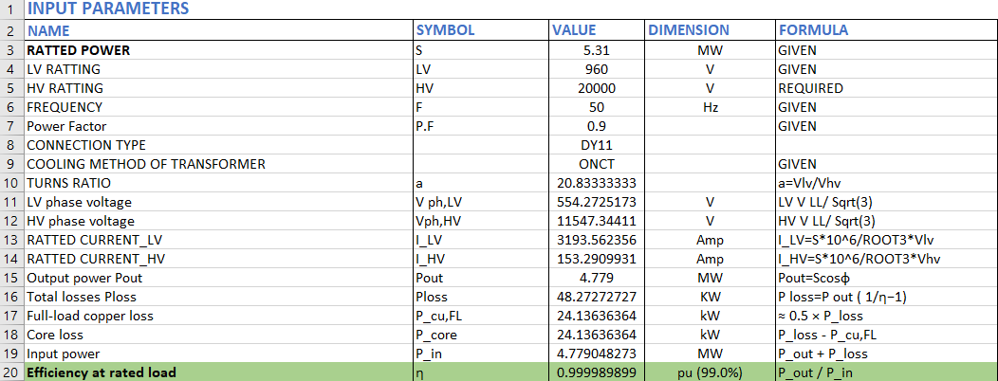
1. Electrical parameter of transformer.
Vishranti Patil

Slide 4
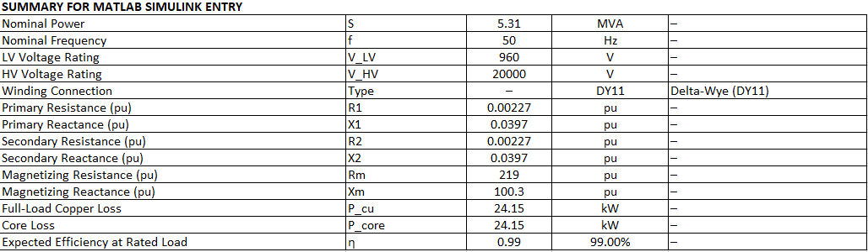
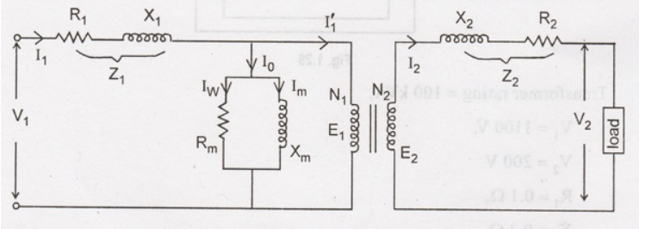

1. Electrical parameter of transformer.
Vishranti Patil

Slide 5
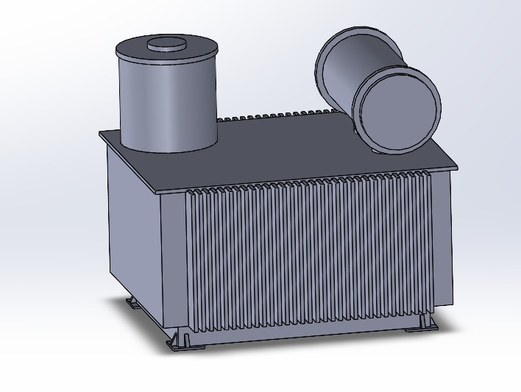
2. Mechanical Dimension of transformer.
960V | Primary side Voltage
20KV | Secondary side Voltage
2.2m × 1.3m × 2.3m(Elsewedy Electric) | Transformer Dimensions (LxHxW)
~7,400 kg | Weight
AN (Air Natural) - No oil required | Cooling
98.0%-99.0% | Efficiency
€232,000 - €257,000 EUR (for the Siemens GEAFOL) €142,500 EUR ( For Elsewedy Electric (Egypt) - Regional Manufacturer | Cost
Transformer scheme . Source [own]. 06.12.2025
For Dimensions ,Weight , Cost we take reference from: [Source. 3] & [Source. 4]
Vishranti Patil

Slide 6
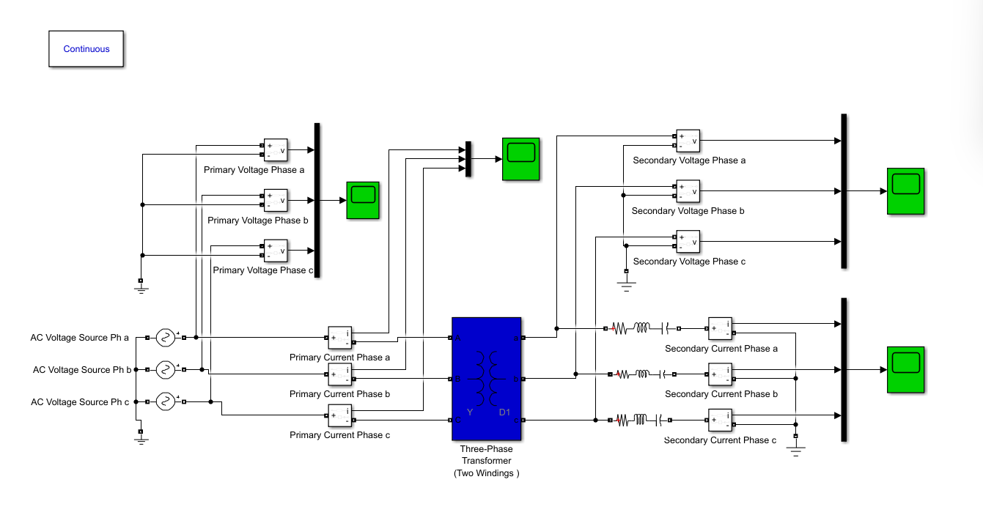
3. Mat lab simulation of transformer.
Transformer scheme . Source [own]. 28.11.2025
Vishranti Patil

Slide 7
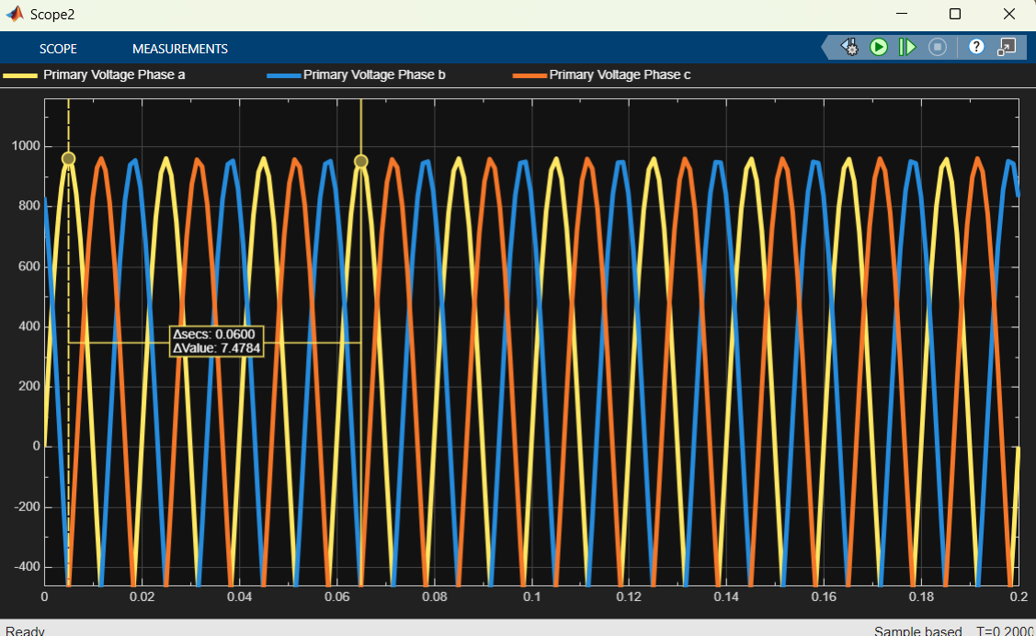
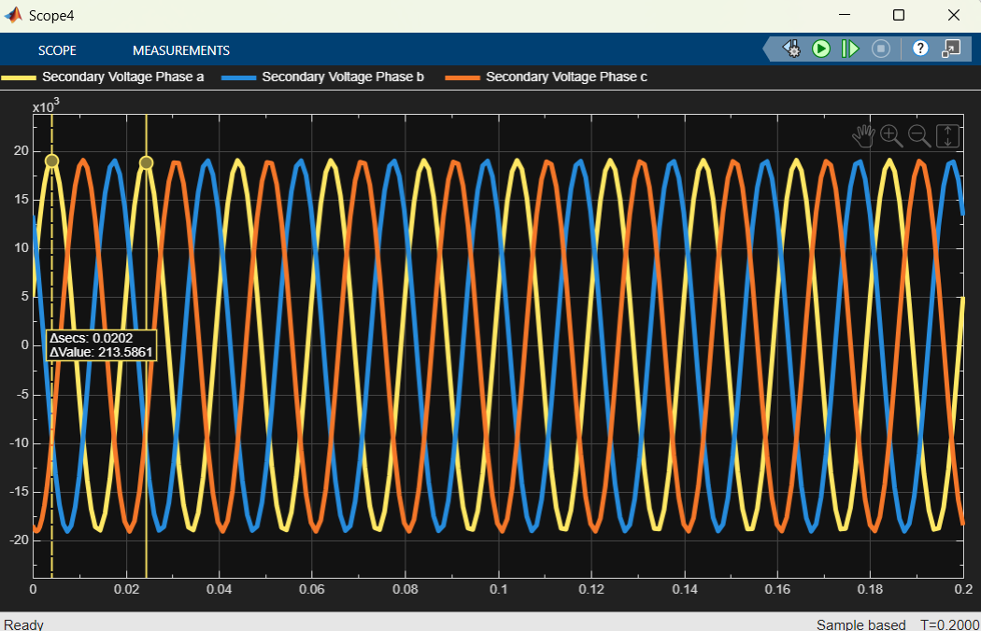
3. Mat lab simulation Result of transformer.
Primary Voltages Secondary Voltages
Transformer scheme . Source [own]. 28.11.2025
Vishranti Patil

Slide 8
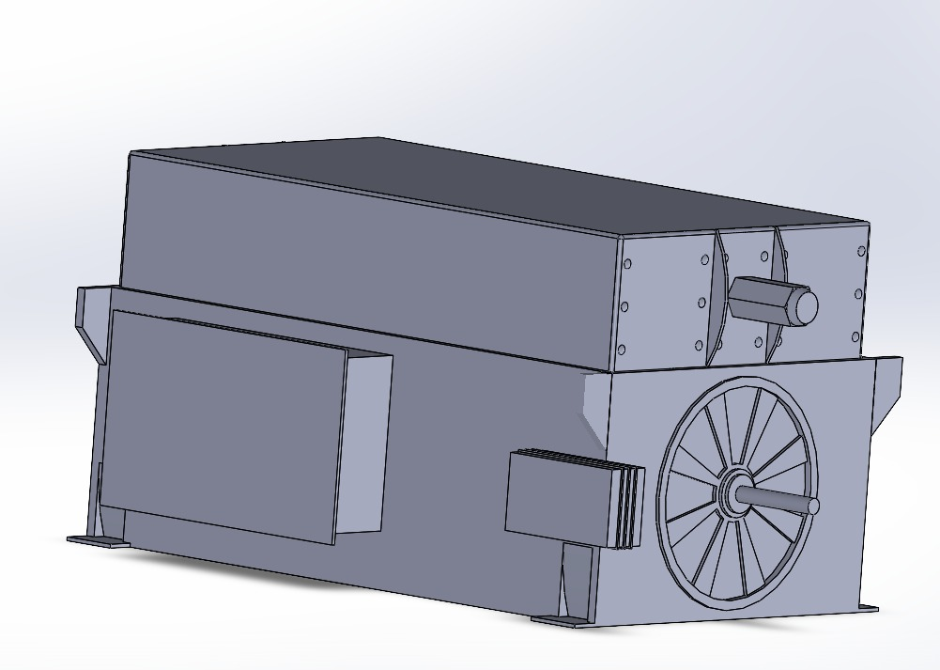
4. Updated Electrical Parameters of Generator.
Active Power | 5.16 MW
Power factor | 0.9
Speed | 1200 rpm
Frequency | 50 Hz
Efficiency | 96.01%- 97.0%
Dimensions (LxHxW) | ABB & VEM 3.5mX1.7mX1.7 m to 2.0m
Weight | 9–12 tonnes
Cost | €1.71Million - €1.90 Million Euro
For Dimensions ,Weight , Cost we take reference from: [Source. 1] & [Source. 2]
Generator scheme . Source [own]. 06.12.2025
Vishranti Patil

Slide 9
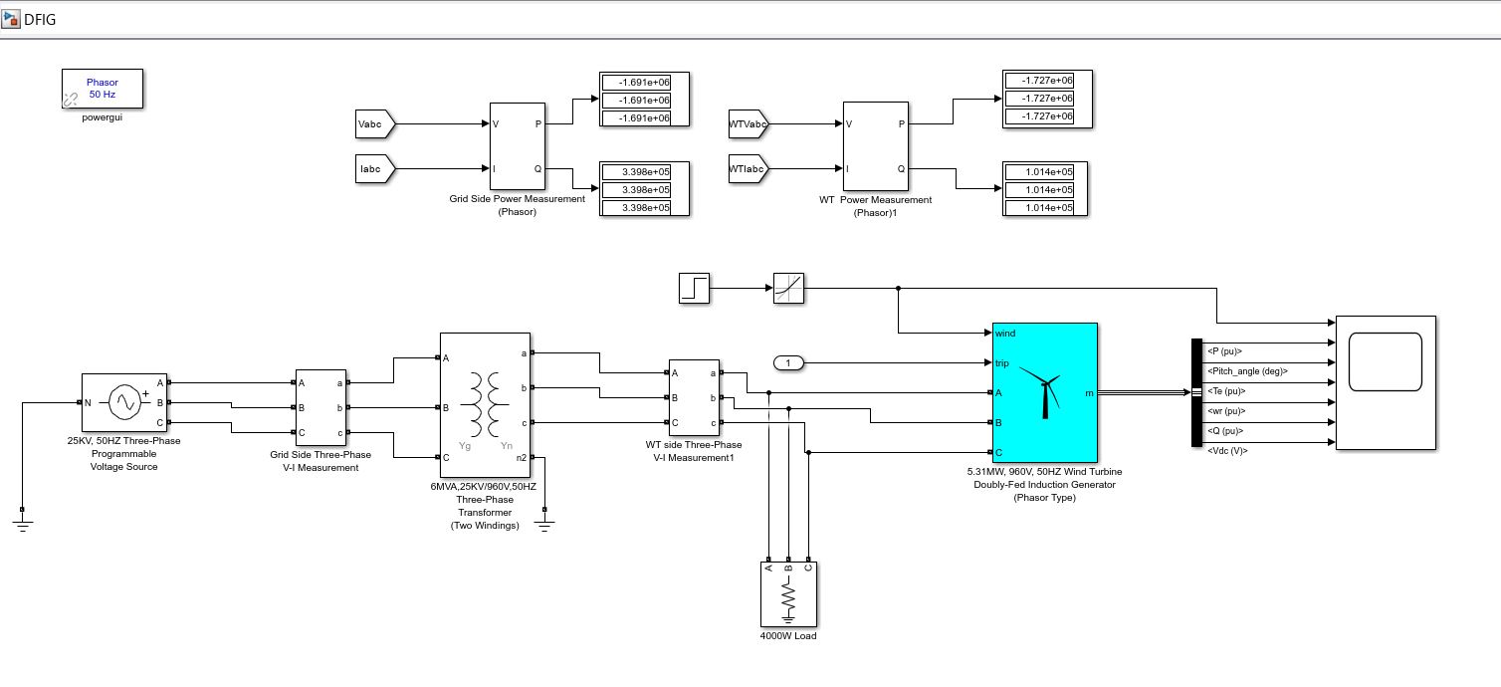

5. Mat lab simulation of Generator
Active Power P= (1.72E+06) +(1.72E+06) +(1.72E+06) =5160000= 5.16MW
Generator scheme .Source [own]. 06.12.2025
Vishranti Patil

Slide 10
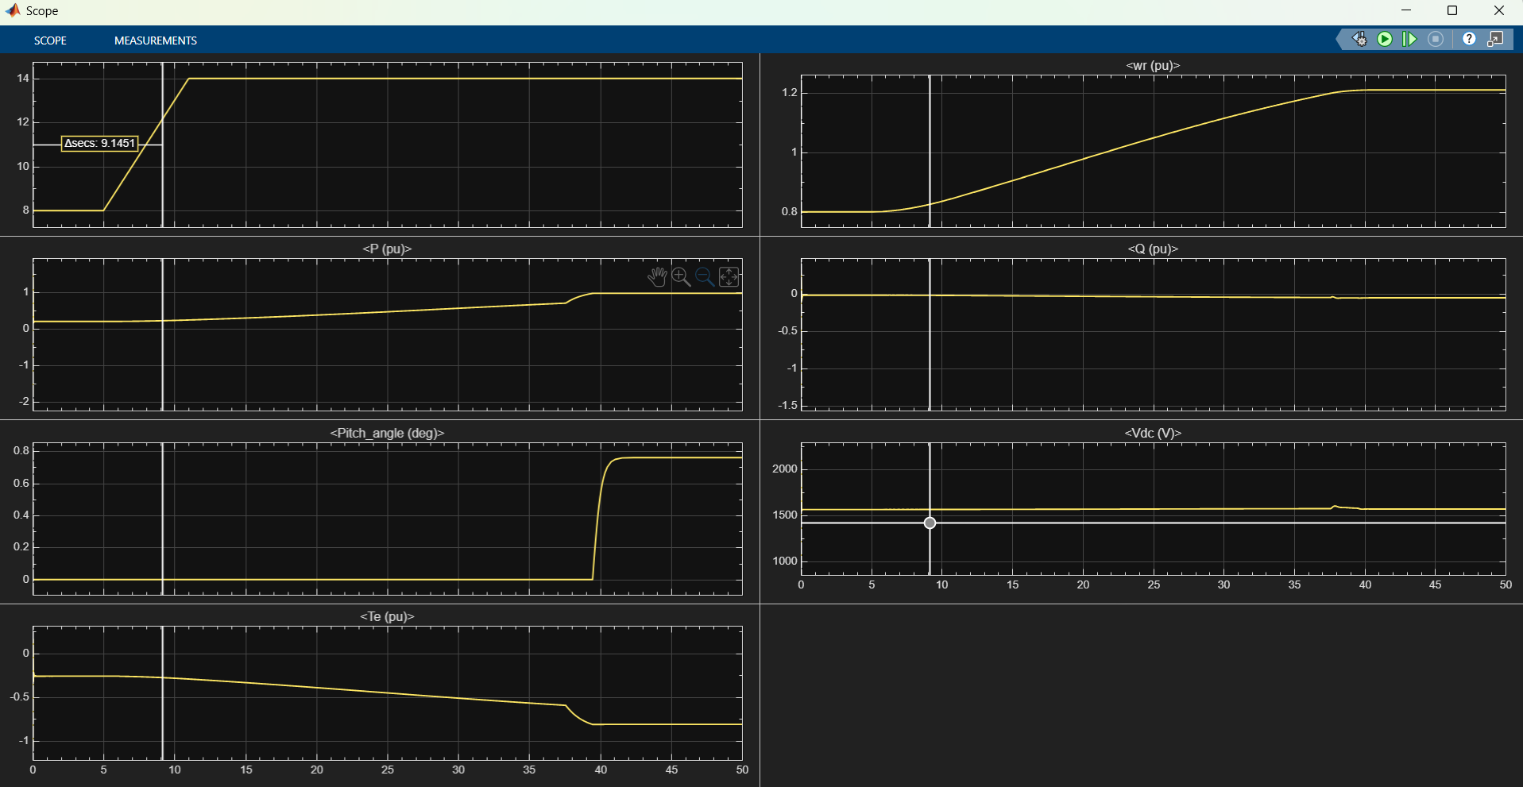
5. Mat lab simulation Result of Generator.
Wind Speed
Rotor Speed
Wind Power per unit
Reactive Power
Pitch Angle
Electrical Torque
Generator scheme .Source [own]. 06.12.2025
Vishranti Patil

Slide 11
6.Next Step
To finalize the simulation for all components combined.
To start the redaction of report and final presentation.
Using power factory results to make final selection of cables and switchgear.
Vishranti Patil

Slide 12

Bibliography
1. Electrical machines and power electronics course Prof.Dr.-Ing Rajesh Saiju,
2. Power system analysis by hadi saadat. [ 25.11.2025]
3. BETA Elektrotechnik GmbH. “Oil Transformers.” BETA–Elektro, accessed November 29, 2025. https://www.beta-elektro.com/oil-transformers
4. Equivalent Circuit of a Transformer,” Poriyaan. [Online]. Available: https://ece.poriyaan.in/topic/equivalent-circuit-of-a-transformer-20011/. [Accessed: Nov. 29, 2025].
5. Electrical engineering for wind turbines course of Prof. Dr. Ingmar Leise. [ 02.12.2025]
6. [Source. 1]ABB, Wind power generators – Standard doubly-fed induction generators. Rev. E, ABB, 06 2019. [Online]. Available: https://library.e.abb.com/public/b86faa2d634f4010baefd88633123c3d/Wind+power+generators+-+Standard+doubly-fed+induction+generators_9AKK105233_RevE_EN+06-2019_lowres.pdf
7. [Source. 2] VEM Sachsenwerk GmbH, “Product overview – VEM Windpower,” VEM-Group, Dresden, Germany, Apr. 2018. [Online]. Available: https://www.vem.fi/wp-content/uploads/2018/04/Product-overview-VEM-Windpower.pdf (accessed Dec. 7, 2025).
8. [Source. 3] Elsewedy Electric, Transformers Focus Catalogue. Elsewedy Electric, Egypt, [Online]. Available: https://elsewedyelectric.com/pdf/Catalouges/05363875/transformers_focus_catalogue.pdf
9. [Source. 4] Siemens Energy, “GEAFOL cast-resin transformers,” Siemens Energy. [Online]. Available: https://www.siemens-energy.com/global/en/home/products-services/product/geafol-dry-type-distribution-transformers.html. [Accessed: Dec. 07, 2025].
10.
02/12/2025

